Slide 1

Deep Diver AI
George Manolachi
A “deep dive” into Stochastic N-Player Planning in Shared-Resource Environments

Slide 2




TABLE OF CONTENTS
01.
03.
02.
04.
PREVIOUS
WORK
ABOUT
THE MODEL
EXPLORATORY DATA ANALYSIS
EVALUATION
& BENCHMARKING

Slide 3


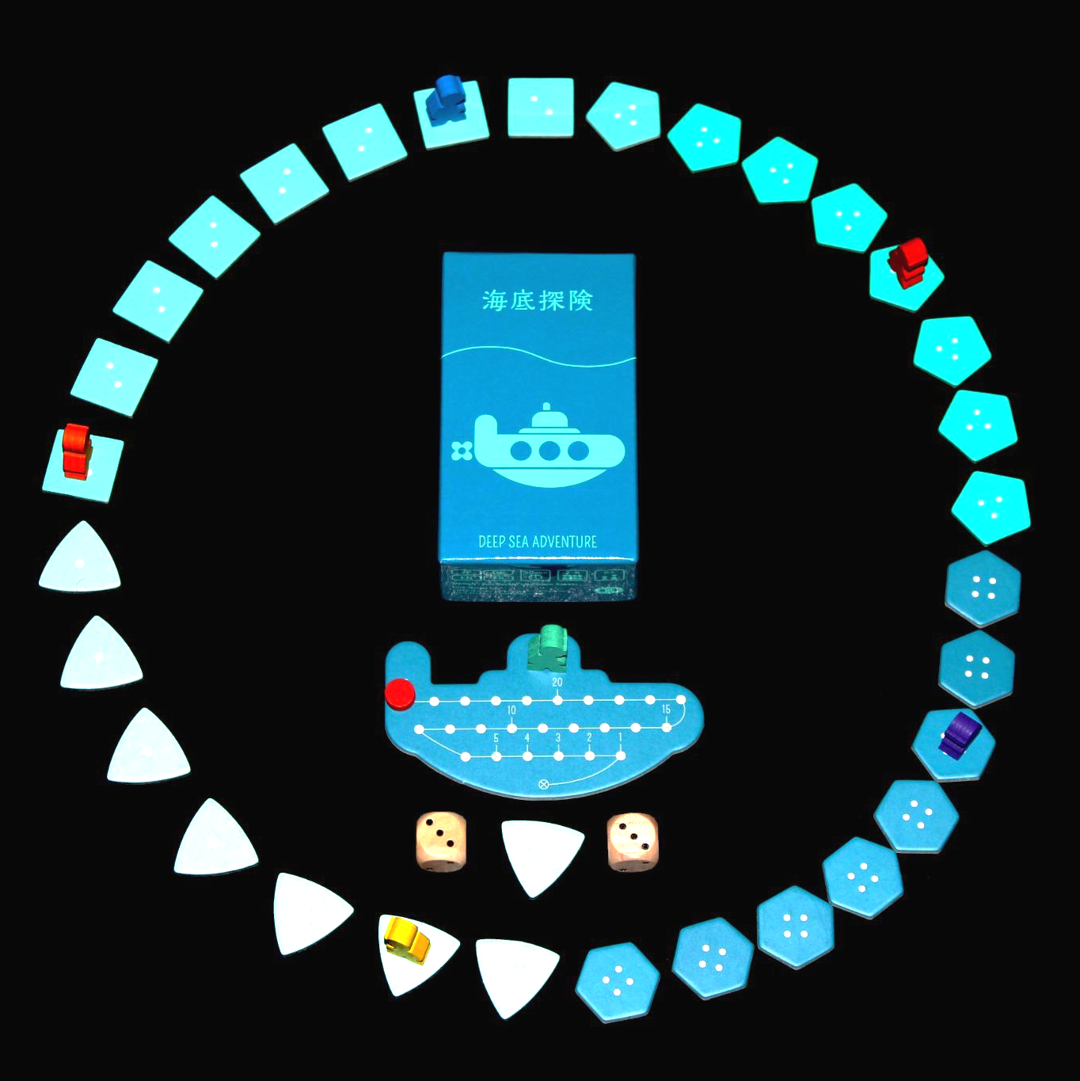


6 Players, One Oxygen Tank.
Deep Sea Adventure is a 2-6 player dice throwing & push-your-luck game where players dive for treasure while sharing the oxygen supply.
Taking treasures slows you down and depletes the oxygen, making it harder to return to the submarine before the air runs out.

Slide 4





01.
PREVIOUS WORK

Slide 5

A Survey of Monte Carlo Tree Search Methods
Browne et al. (2012)
Monte-Carlo Tree Reductions for Stochastic Games
Cazenave & Jouandeau (2010)
A definitive survey of Monte Carlo Tree Search methods, outlining core variants, strengths, and limitations.
This work provides the foundational understanding of MCTS that my work extends for stochastic, multi-player environments.
Proposes techniques for integrating chance nodes and reducing branching in stochastic games.
This directly informs my handling of dice rolls and probabilistic transitions within the Deep Sea Adventure environment.

Slide 6
An Analysis of Monte Carlo Tree Search in Multiplayer Games
Sturtevant (2008)
Planning in Stochastic Environments with a Learned Model
Schrittwieser et al. (2021)
Investigates how MCTS behaves in multiplayer and non-zero-sum settings, highlighting challenges in utility propagation and opponent modeling.
This work motivates my adjustments to backpropagation for N-player scoring and interdependent outcomes.
Demonstrates effective planning in stochastic environments using model-based tree search.
Their approach reinforces the importance of explicitly representing uncertainty instead of collapsing randomness into averages, which aligns with my use of chance nodes.

Slide 7
02.
EXPLORATORY DATA ANALYSIS

Slide 8
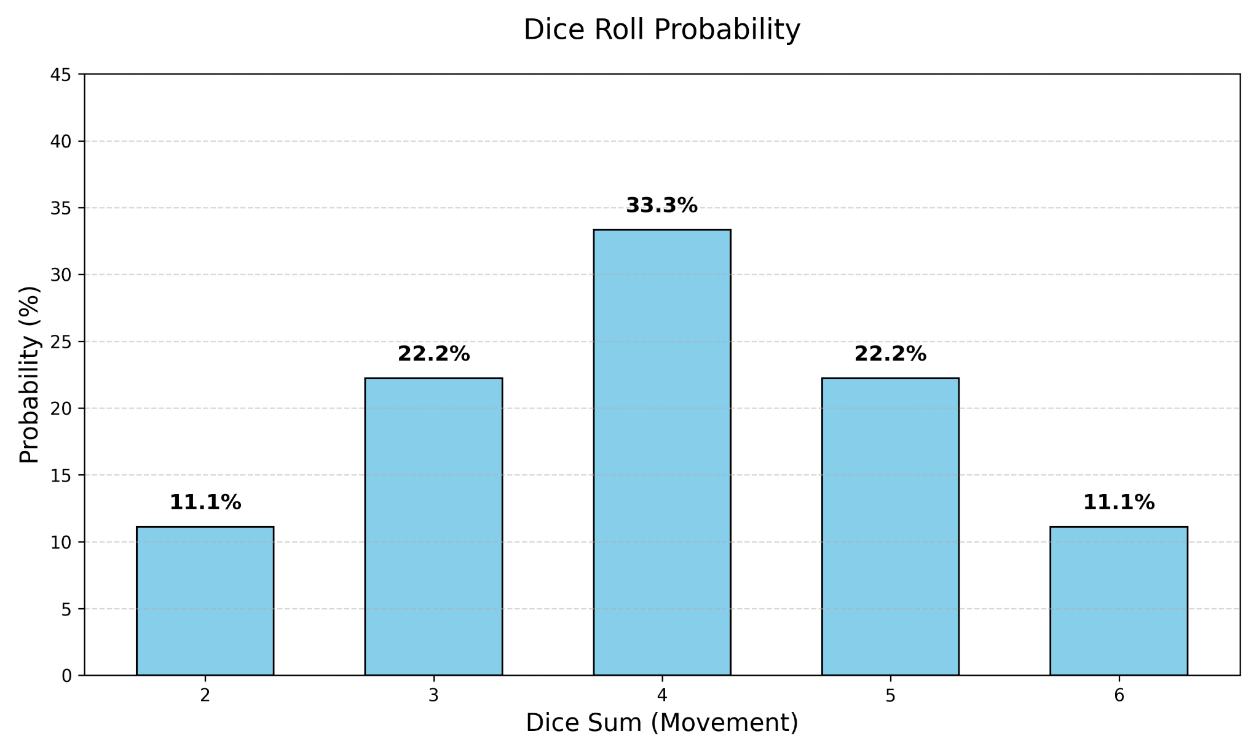
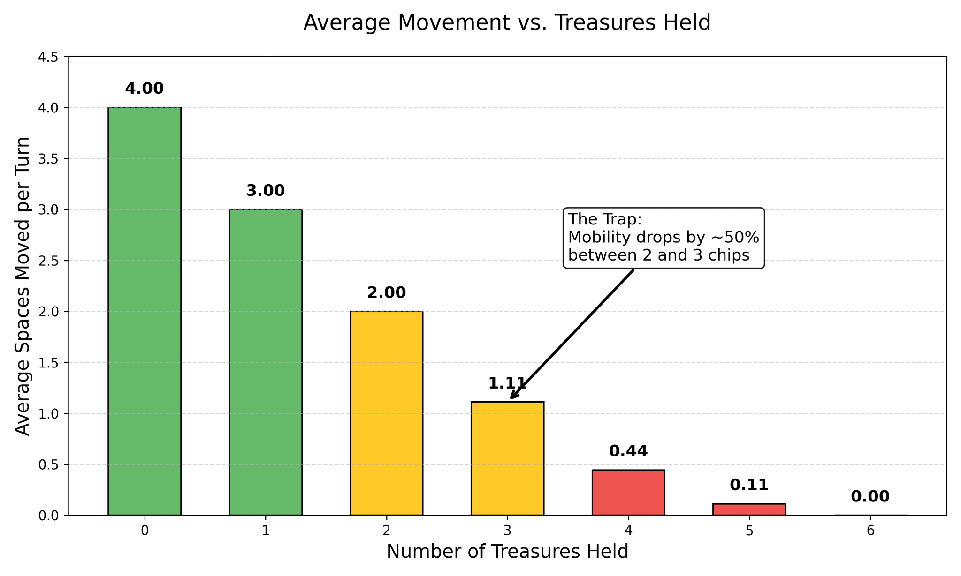

The Trap

Slide 9
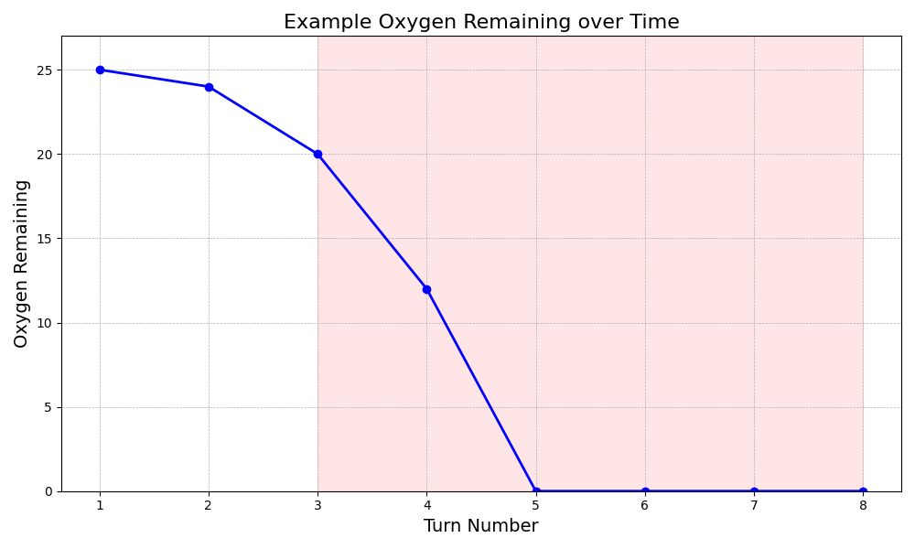
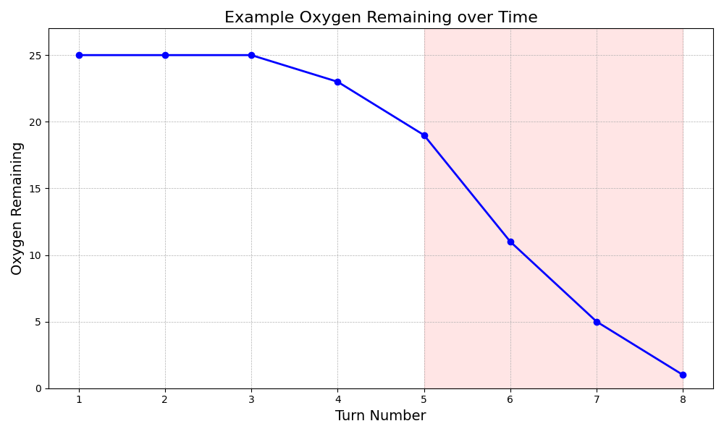
Greedy vs Safe

Slide 10
03.
ABOUT THE
MODEL

Slide 11


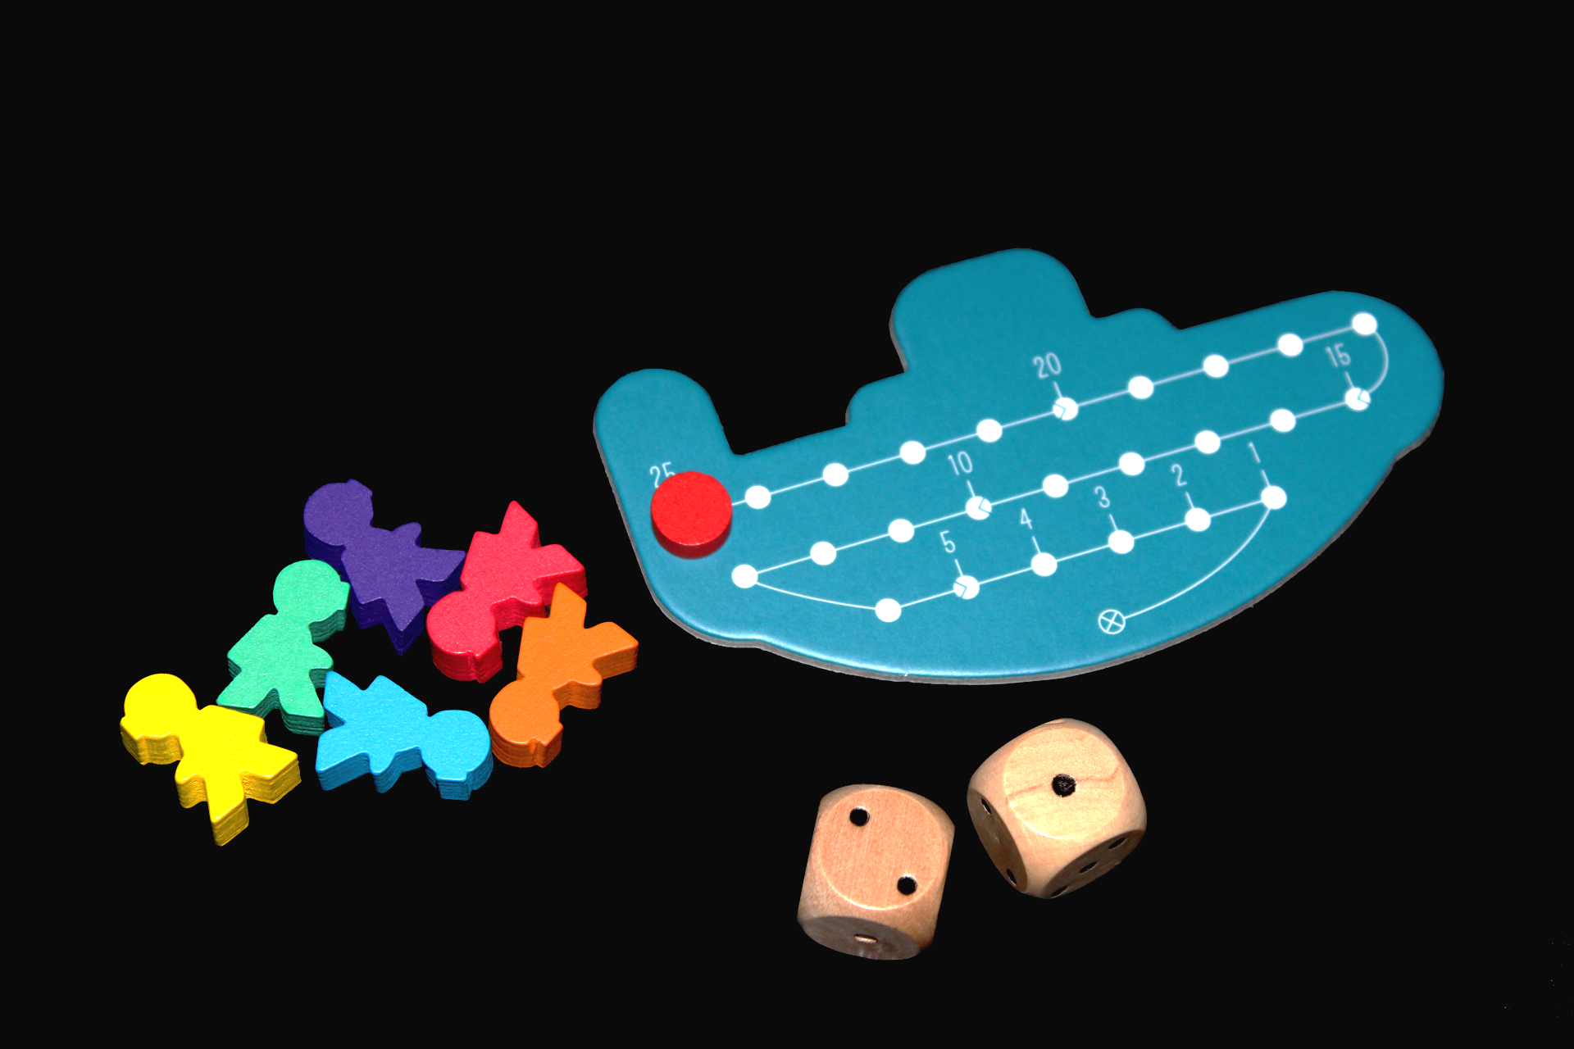
Monte Carlo Tree Search

Slide 12

Chance Nodes

Slide 13
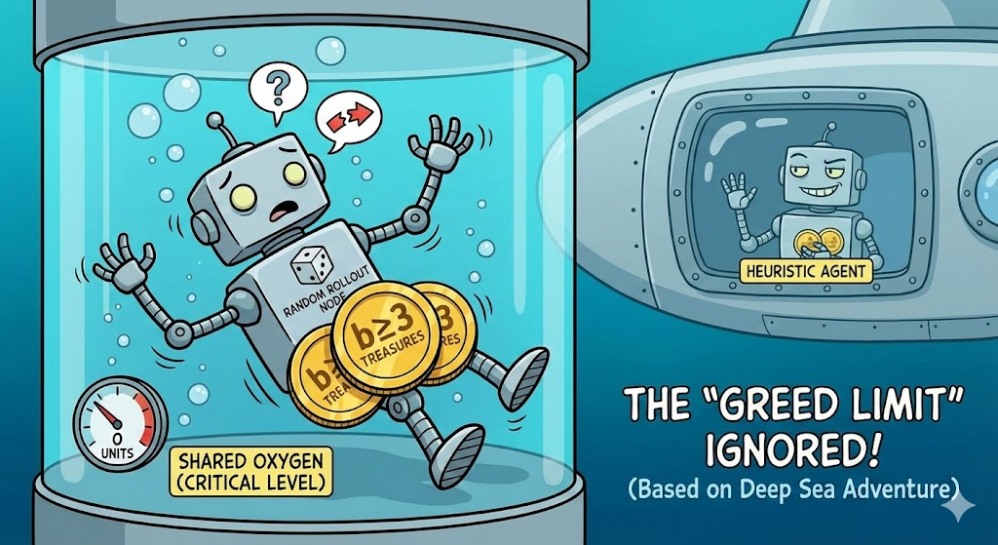
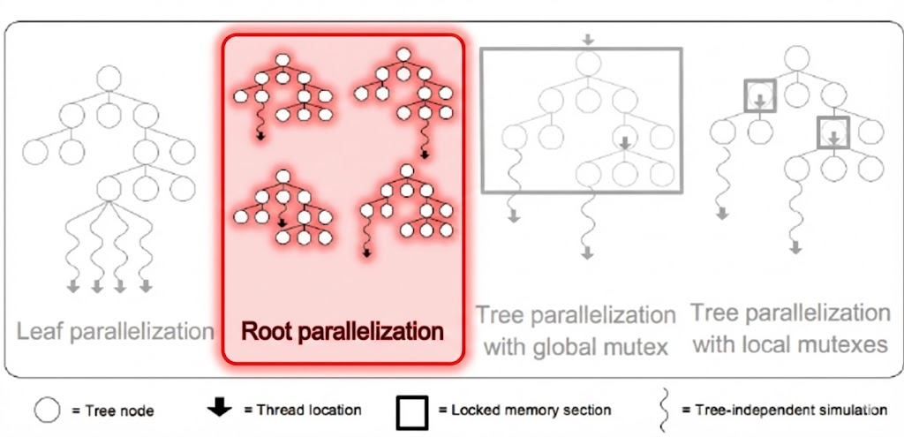
Optimisations
Heuristic Policy
Root Parallelization

Slide 14
04.
METRICS OF
SUCCESS

Slide 15
Benchmarks
Baseline Dominance
The MCTS agent must consistently defeat a baseline heuristic opponent
Target: Win Rate >95%
Search Efficiency
Measuring the performance of the C++ engine (both environment and MCTS)
Metric: Nodes Per Second (NPS)

Slide 16
Thank You!

